Slide 1

Chapter 3
Transport Layer
Computer Networking: A Top Down Approach
5th edition.
Jim Kurose, Keith Ross
Addison-Wesley, April 2009.
Transport Layer
3-<number>

Slide 2
Chapter 3: Transport Layer
Our goals:
understand principles behind transport layer services:
  multiplexing/demultiplexing
  reliable data transfer
  flow control
  congestion control
learn about transport layer protocols in the Internet:
  UDP: connectionless transport
  TCP: connection-oriented transport
  TCP congestion control
Transport Layer
3-<number>

Slide 3
Chapter 3 outline
3.1 Transport-layer services
3.2 Multiplexing and demultiplexing
3.3 Connectionless transport: UDP
3.4 Principles of reliable data transfer
3.5 Connection-oriented transport: TCP
  segment structure
  reliable data transfer
  flow control
  connection management
3.6 Principles of congestion control
3.7 TCP congestion control
Transport Layer
3-<number>

Slide 4





Transport services and protocols
application
transport
network
data link
physical
provide logical communication between app processes running on different hosts
transport protocols run in end systems
  send side: breaks app messages into segments, passes to network layer
  rcv side: reassembles segments into messages, passes to app layer
more than one transport protocol available to apps
  Internet: TCP and UDP
logical end-end transport
application
transport
network
data link
physical
Transport Layer
3-<number>

Slide 5
Transport vs. network layer
network layer: logical communication between hosts
transport layer: logical communication between processes
  relies on, enhances, network layer services
Household analogy:
12 kids sending letters to 12 kids
processes = kids
app messages = letters in envelopes
hosts = houses
transport protocol = Ann and Bill
network-layer protocol = postal service
Transport Layer
3-<number>

Slide 6
传输层与网络层的关系
网络层
  功能：主机通信
  协议：IP
  特点：hop-by-hop
传输层
  功能：进程通信
  协议：UDP和TCP
  特点：end-to-end

Slide 7
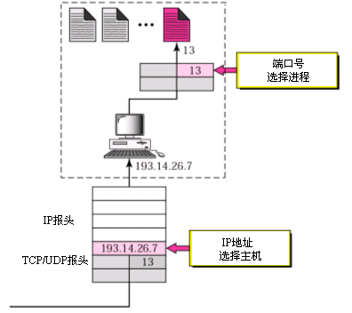
IP地址和端口

Slide 8
Internet transport-layer protocols
reliable, in-order delivery (TCP)
  congestion control
  flow control
  connection setup
unreliable, unordered delivery: UDP
  no-frills extension of “best-effort” IP
services not available:
  delay guarantees
  bandwidth guarantees
application
transport
network
data link
physical
network
data link
physical
network
data link
physical
logical end-end transport
network
data link
physical
network
data link
physical
network
data link
physical
network
data link
physical
application
transport
network
data link
physical
Transport Layer
3-<number>

Slide 9
Chapter 3 outline
3.1 Transport-layer services
3.2 Multiplexing and demultiplexing
3.3 Connectionless transport: UDP
3.4 Principles of reliable data transfer
3.5 Connection-oriented transport: TCP
  segment structure
  reliable data transfer
  flow control
  connection management
3.6 Principles of congestion control
3.7 TCP congestion control
Transport Layer
3-<number>

Slide 10
Multiplexing/demultiplexing
Demultiplexing at rcv host:
Multiplexing at send host:
delivering received segments
to correct socket
gathering data from multiple
sockets, enveloping data with
header (later used for
demultiplexing)
= socket
= process
application
application
application
P4
P3
P1
P2
P1
transport
transport
transport
network
network
network
link
link
link
physical
physical
physical
host 1
host 2
host 3
Transport Layer
3-<number>

Slide 11
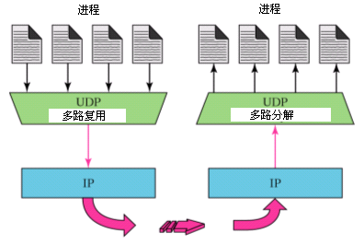
UDP多路复用

Slide 12
How demultiplexing works
host receives IP datagrams
  each datagram has source IP address, destination IP address
  each datagram carries 1 transport-layer segment
  each segment has source, destination port number
host uses IP addresses & port numbers to direct segment to appropriate socket
32 bits
source port #
dest port #
other header fields
application
data
(message)
TCP/UDP segment format
Transport Layer
3-<number>

Slide 13
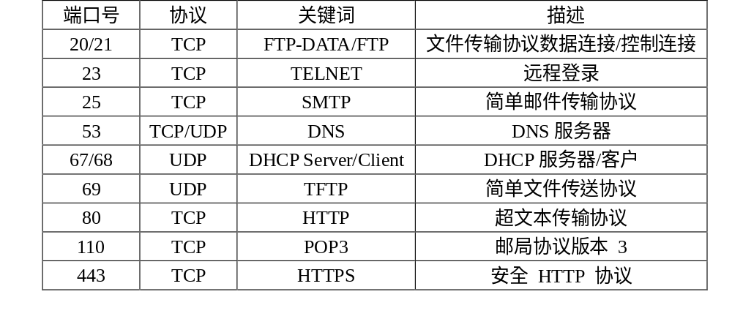
TCP/UDP 众所周知端口号

Slide 14
Connectionless demultiplexing
When host receives UDP segment:
  checks destination port number in segment
  directs UDP segment to socket with that port number
IP datagrams with different source IP addresses and/or source port numbers directed to same socket
Create sockets with port numbers:
DatagramSocket mySocket1 = new DatagramSocket(12534);
DatagramSocket mySocket2 = new DatagramSocket(12535);
UDP socket identified by two-tuple:
(dest IP address, dest port number)
Transport Layer
3-<number>

Slide 15
Connectionless demux (cont)
DatagramSocket serverSocket = new DatagramSocket(6428);
P2
P1
P3
P1
SP: 6428
SP: 6428
DP: 9157
DP: 5775
SP: 9157
SP: 5775
client
IP: A
DP: 6428
server
IP: C
DP: 6428
Client
IP:B
SP provides “return address”
Transport Layer
3-<number>

Slide 16
Connection-oriented demux
TCP socket identified by 4-tuple:
  source IP address
  source port number
  dest IP address
  dest port number
recv host uses all four values to direct segment to appropriate socket
Server host may support many simultaneous TCP sockets:
  each socket identified by its own 4-tuple
Web servers have different sockets for each connecting client
  non-persistent HTTP will have different socket for each request
Transport Layer
3-<number>

Slide 17
Connection-oriented demux (cont)
P1
P4
P5
P6
P2
P1
P3
SP: 5775
DP: 80
S-IP: B
D-IP:C
SP: 9157
SP: 9157
client
IP: A
DP: 80
server
IP: C
DP: 80
Client
IP:B
S-IP: A
S-IP: B
D-IP:C
D-IP:C
Transport Layer
3-<number>

Slide 18
Connection-oriented demux: Threaded Web Server
P1
P4
P2
P1
P3
SP: 5775
DP: 80
S-IP: B
D-IP:C
SP: 9157
SP: 9157
client
IP: A
DP: 80
server
IP: C
DP: 80
Client
IP:B
S-IP: A
S-IP: B
D-IP:C
D-IP:C
Transport Layer
3-<number>

Slide 19
Chapter 3 outline
3.1 Transport-layer services
3.2 Multiplexing and demultiplexing
3.3 Connectionless transport: UDP
3.4 Principles of reliable data transfer
3.5 Connection-oriented transport: TCP
  segment structure
  reliable data transfer
  flow control
  connection management
3.6 Principles of congestion control
3.7 TCP congestion control
Transport Layer
3-<number>

Slide 20
UDP: User Datagram Protocol [RFC 768]
“no frills,” “bare bones” Internet transport protocol
“best effort” service, UDP segments may be:
  lost
  delivered out of order to app
connectionless:
  no handshaking between UDP sender, receiver
  each UDP segment handled independently of others
Why is there a UDP?
no connection establishment (which can add delay)
simple: no connection state at sender, receiver
small segment header
no congestion control: UDP can blast away as fast as desired
Transport Layer
3-<number>

Slide 21
UDP: more
often used for streaming multimedia apps
  loss tolerant
  rate sensitive
other UDP uses
  DNS
  SNMP
reliable transfer over UDP: add reliability at application layer
  application-specific error recovery!
32 bits
Length, in
bytes of UDP
segment,
including
header
source port #
dest port #
length
checksum
Application
data
(message)
UDP segment format
Transport Layer
3-<number>

Slide 22
7.2 UDP协议
提供主机通信
IP服务特性
  报文可能丢失
  报文可能出错
  报文可能乱序到达
  报文在网络上可能被延迟任意长时间
支持多路复用
提供进程通信
UDP服务特性
  报文可能丢失
  报文可能出错
  报文可能乱序到达
  报文在网络上可能被延迟任意长时间
支持多路复用

Slide 23
IP与UDP关系
IP
  提供主机通信
  通信对象命名是IP 地址
  IP地址定位到主机
UDP
  提供进程通信
  通信对象命名是Port 号
  Port号定位到进程

Slide 24
UDP checksum
Goal: detect “errors” (e.g., flipped bits) in transmitted segment
Sender:
treat segment contents as sequence of 16-bit integers
checksum: addition (1’s complement sum) of segment contents
sender puts checksum value into UDP checksum field
Receiver:
compute checksum of received segment
check if computed checksum equals checksum field value:
  NO - error detected
  YES - no error detected. But maybe errors nonetheless? More later ….
Transport Layer
3-<number>

Slide 25
Internet Checksum Example
Note
  When adding numbers, a carryout from the most significant bit needs to be added to the result
Example: add two 16-bit integers
1 1 1 1 0 0 1 1 0 0 1 1 0 0 1 1 0
1 1 1 0 1 0 1 0 1 0 1 0 1 0 1 0 1
1 1 0 1 1 1 0 1 1 1 0 1 1 1 0 1 1
1 1 0 1 1 1 0 1 1 1 0 1 1 1 1 0 0
1 0 1 0 0 0 1 0 0 0 1 0 0 0 0 1 1
wraparound
sum
checksum
Transport Layer
3-<number>
Notes:
Kurose and Ross forgot to say anything about wrapping the carry and adding it to low order bit

Slide 26
Chapter 3 outline
3.1 Transport-layer services
3.2 Multiplexing and demultiplexing
3.3 Connectionless transport: UDP
3.4 Principles of reliable data transfer
3.5 Connection-oriented transport: TCP
  segment structure
  reliable data transfer
  flow control
  connection management
3.6 Principles of congestion control
3.7 TCP congestion control
Transport Layer
3-<number>

Slide 27

Principles of Reliable data transfer
important in app., transport, link layers
top-10 list of important networking topics!
characteristics of unreliable channel will determine complexity of reliable data transfer protocol (rdt)
Transport Layer
3-<number>

Slide 28
Principles of Reliable data transfer
important in app., transport, link layers
top-10 list of important networking topics!
characteristics of unreliable channel will determine complexity of reliable data transfer protocol (rdt)
Transport Layer
3-<number>

Slide 29
Principles of Reliable data transfer
important in app., transport, link layers
top-10 list of important networking topics!
characteristics of unreliable channel will determine complexity of reliable data transfer protocol (rdt)
Transport Layer
3-<number>

Slide 30

Reliable data transfer: getting started
rdt_send(): called from above, (e.g., by app.). Passed data to
deliver to receiver upper layer
deliver_data(): called by rdt to deliver data to upper
send
side
receive
side
udt_send(): called by rdt,
to transfer packet over
unreliable channel to receiver
rdt_rcv(): called when packet arrives on rcv-side of channel
Transport Layer
3-<number>

Slide 31
Reliable data transfer: getting started
We’ll:
incrementally develop sender, receiver sides of reliable data transfer protocol (rdt)
consider only unidirectional data transfer
  but control info will flow on both directions!
use finite state machines (FSM) to specify sender, receiver
event causing state transition
actions taken on state transition
state: when in this “state” next state uniquely determined by next event
state
1
state
2
event
actions
Transport Layer
3-<number>

Slide 32
Rdt1.0: reliable transfer over a reliable channel
underlying channel perfectly reliable
  no bit errors
  no loss of packets
separate FSMs for sender, receiver:
  sender sends data into underlying channel
  receiver read data from underlying channel
启动
启动
Wait for call from above
rdt_send(data)
Wait for call from below
rdt_rcv(packet)
extract (packet,data)
deliver_data(data)
packet = make_pkt(data)
udt_send(packet)
上交数据
sender
receiver
Transport Layer
3-<number>

Slide 33
Rdt1.0 存在何问题？
It is a idealization !
在目前的技术条件下，假设不合理的!
How dose the network protocol grow up!
网络协议是怎样炼成的？！
Transport Layer
3-<number>

Slide 34
Rdt2.0: channel with bit errors
underlying channel may flip bits in packet
  checksum to detect bit errors
the question: how to recover from errors:
  acknowledgements (ACKs): receiver explicitly tells sender that pkt received OK
  negative acknowledgements (NAKs): receiver explicitly tells sender that pkt had errors
  sender retransmits pkt on receipt of NAK
new mechanisms in rdt2.0 (beyond rdt1.0):
  error detection
  receiver feedback: control msgs (ACK,NAK) rcvr->sender
Transport Layer
3-<number>

Slide 35
rdt2.0: FSM specification
rdt_send(data)
snkpkt = make_pkt(data, checksum)
udt_send(sndpkt)
receiver
rdt_rcv(rcvpkt) &&
isNAK(rcvpkt)
Wait for call from above
Wait for ACK or NAK
rdt_rcv(rcvpkt) &&
corrupt(rcvpkt)
报文错
udt_send(sndpkt)
重传
udt_send(NAK)
发送NAK
rdt_rcv(rcvpkt) && isACK(rcvpkt)
等待调用
Λ
Wait for call from below
sender
rdt_rcv(rcvpkt) &&
notcorrupt(rcvpkt)
报文对
extract(rcvpkt,data)
deliver_data(data)
udt_send(ACK)
上交数据
发送ACK
Transport Layer
3-<number>

Slide 36
rdt2.0: operation with no errors
rdt_send(data)
snkpkt = make_pkt(data, checksum)
udt_send(sndpkt)
rdt_rcv(rcvpkt) &&
isNAK(rcvpkt)
Wait for call from above
Wait for ACK or NAK
rdt_rcv(rcvpkt) &&
corrupt(rcvpkt)
udt_send(sndpkt)
udt_send(NAK)
rdt_rcv(rcvpkt) && isACK(rcvpkt)
Wait for call from below
Λ
rdt_rcv(rcvpkt) &&
notcorrupt(rcvpkt)
extract(rcvpkt,data)
deliver_data(data)
udt_send(ACK)
Transport Layer
3-<number>

Slide 37
rdt2.0: error scenario
rdt_send(data)
snkpkt = make_pkt(data, checksum)
udt_send(sndpkt)
启动
rdt_rcv(rcvpkt) &&
isNAK(rcvpkt)
Wait for call from above
Wait for ACK or NAK
rdt_rcv(rcvpkt) &&
corrupt(rcvpkt)
udt_send(sndpkt)
udt_send(NAK)
rdt_rcv(rcvpkt) && isACK(rcvpkt)
Wait for call from below
Λ
rdt_rcv(rcvpkt) &&
notcorrupt(rcvpkt)
extract(rcvpkt,data)
deliver_data(data)
udt_send(ACK)
Transport Layer
3-<number>

Slide 38
rdt2.0 has a fatal flaw!
What happens if ACK/NAK corrupted?
ACK/NAK 出错后会怎么样？
sender doesn’t know what happened at receiver!
can’t just retransmit: possible duplicate
Handling duplicates:
sender retransmits current pkt if ACK/NAK garbled
sender adds sequence number to each pkt
receiver discards (doesn’t deliver up) duplicate pkt
stop and wait
Sender sends one packet,
then waits for receiver
response
Transport Layer
3-<number>

Slide 39
rdt2.1: sender, handles garbled (混淆) ACK/NAKs
rdt_send(data)
sndpkt = make_pkt(0, data, checksum)
udt_send(sndpkt)
发送报文#0
rdt_rcv(rcvpkt) &&
( corrupt(rcvpkt) ||
isNAK(rcvpkt) )
启动
Wait for call 0 from above
Wait for ACK or NAK 0
重传
udt_send(sndpkt)
rdt_rcv(rcvpkt)
&& notcorrupt(rcvpkt)
&& isACK(rcvpkt)
rdt_rcv(rcvpkt)
&& notcorrupt(rcvpkt)
&& isACK(rcvpkt)
Λ
Λ
Wait for ACK or NAK 1
Wait for
call 1 from above
rdt_rcv(rcvpkt) &&
( corrupt(rcvpkt) ||
isNAK(rcvpkt) )
rdt_send(data)
udt_send(sndpkt)
重传
sndpkt = make_pkt(1, data, checksum)
udt_send(sndpkt)
发送报文#1
Transport Layer
3-<number>

Slide 40
rdt2.1: receiver, handles garbled(混淆) ACK/NAKs
rdt_rcv(rcvpkt) && notcorrupt(rcvpkt)
&& has_seq0(rcvpkt)
收到报文#0
extract(rcvpkt,data)
deliver_data(data)
sndpkt = make_pkt(ACK, chksum)
udt_send(sndpkt)
启动
发送ACK
rdt_rcv(rcvpkt) && (corrupt(rcvpkt)
rdt_rcv(rcvpkt) && (corrupt(rcvpkt)
sndpkt = make_pkt(NAK, chksum)
udt_send(sndpkt)
sndpkt = make_pkt(NAK, chksum)
udt_send(sndpkt)
发送NAK
发送NAK
Wait for
0 from below
Wait for
1 from below
rdt_rcv(rcvpkt) &&
not corrupt(rcvpkt) &&
has_seq1(rcvpkt)
rdt_rcv(rcvpkt) &&
not corrupt(rcvpkt) &&
has_seq0(rcvpkt)
收到报文#1
收到报文#0
sndpkt = make_pkt(ACK, chksum)
udt_send(sndpkt)
sndpkt = make_pkt(ACK, chksum)
udt_send(sndpkt)
发送ACK
rdt_rcv(rcvpkt) && notcorrupt(rcvpkt)
&& has_seq1(rcvpkt)
发送ACK
收到报文#1
extract(rcvpkt,data)
deliver_data(data)
sndpkt = make_pkt(ACK, chksum)
udt_send(sndpkt)
发送ACK
Transport Layer
3-<number>

Slide 41
rdt2.1: discussion
Sender:
seq # added to pkt
two seq. #’s (0,1) will suffice. Why?
must check if received ACK/NAK corrupted
twice as many states
  state must “remember” whether “current” pkt has 0 or 1 seq. #
Receiver:
must check if received packet is duplicate
  state indicates whether 0 or 1 is expected pkt seq #
note: receiver can not know if its last ACK/NAK received OK at sender
Transport Layer
3-<number>

Slide 42
Rdt2.1 是否有改进的地方？
只使用ACK 应答机制，
协议能否正常工作？
Transport Layer
3-<number>

Slide 43
rdt2.2: a NAK-free protocol
same functionality as rdt2.1, using ACKs only
instead of NAK, receiver sends ACK for last pkt received OK
  receiver must explicitly include seq # of pkt being ACKed (ACK number)
duplicate ACK at sender results in same action as NAK: retransmit current pkt
  重复ACK意味着需要重传某帧
Transport Layer
3-<number>

Slide 44
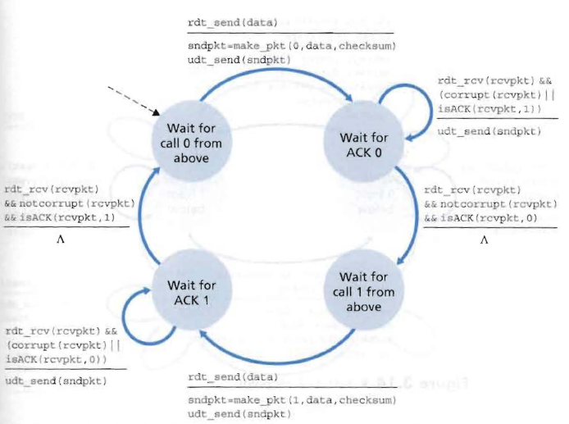
rdt2.2: sender
Transport Layer
3-<number>

Slide 45
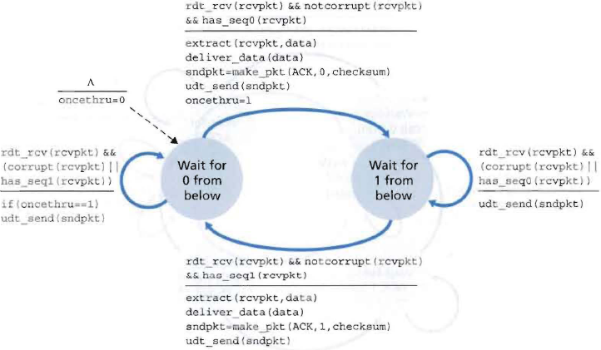
rdt2.2: receiver
Transport Layer
3-<number>

Slide 46
rdt2.2: sender, receiver fragments
rdt_send(data)
sndpkt = make_pkt(0, data, checksum)
udt_send(sndpkt)
启动
rdt_rcv(rcvpkt) &&
( corrupt(rcvpkt) ||
isACK(rcvpkt,1) )
Wait for call 0 from above
Wait for ACK
0
udt_send(sndpkt)
重传
sender FSM
fragment
rdt_rcv(rcvpkt)
&& notcorrupt(rcvpkt)
&& isACK(rcvpkt,0)
启动
rdt_rcv(rcvpkt) &&
(corrupt(rcvpkt) ||
has_seq1(rcvpkt))
Λ
Wait for
0 from below
receiver FSM
fragment
udt_send(sndpkt)
发送ACK1
rdt_rcv(rcvpkt) && notcorrupt(rcvpkt)
&& has_seq1(rcvpkt)
extract(rcvpkt,data)
deliver_data(data)
sndpkt = make_pkt(ACK, 1, chksum)
udt_send(sndpkt)
发送ACK1
Transport Layer
3-<number>

Slide 47
Rdt2.2 存在的问题是什么？
信道不丢包的假设不合理
如果丢包则协议无法正常工作 ?
Transport Layer
3-<number>

Slide 48
rdt3.0: channels with errors and loss
New assumption: underlying channel can also lose packets (data or ACKs)
  checksum, seq. #, ACKs, retransmissions will be of help, but not enough
Approach: sender waits “reasonable” amount of time for ACK - timer
retransmits if no ACK received in this time
if pkt (or ACK) just delayed (not lost):
  retransmission will be duplicate, but use of seq. #’s already handles this
  receiver must specify seq # of pkt being ACKed
requires countdown timer
Transport Layer
3-<number>

Slide 49
rdt3.0 sender
启动
rdt_send(data)
rdt_rcv(rcvpkt) &&
( corrupt(rcvpkt) ||
isACK(rcvpkt,1) )
sndpkt = make_pkt(0, data, checksum)
udt_send(sndpkt)
start_timer
发送报文#0
rdt_rcv(rcvpkt)
启动定时器
Λ
Λ
Wait for
call 0 from above
Wait for ACK0
timeout
重传报文#0
udt_send(sndpkt)
start_timer
rdt_rcv(rcvpkt)
&& notcorrupt(rcvpkt)
&& isACK(rcvpkt,1)
rdt_rcv(rcvpkt)
&& notcorrupt(rcvpkt)
&& isACK(rcvpkt,0)
stop_timer
stop_timer
Wait for ACK1
Wait for
call 1 from above
timeout
udt_send(sndpkt)
start_timer
rdt_rcv(rcvpkt)
重传报文#1
rdt_send(data)
Λ
rdt_rcv(rcvpkt) &&
( corrupt(rcvpkt) ||
isACK(rcvpkt,0) )
sndpkt = make_pkt(1, data, checksum)
udt_send(sndpkt)
start_timer
发送报文#1
启动定时器
Λ
Transport Layer
3-<number>

Slide 50

rdt3.0 in action
Transport Layer
3-<number>

Slide 51

rdt3.0 in action
过早超时
Transport Layer
3-<number>

Slide 52
Rdt3.0 存在何问题？
上述协议都基于”停—等”思路，称为停等协议（Stop-Wait Protocao）,协议的效率如何 ？
Transport Layer
3-<number>

Slide 53
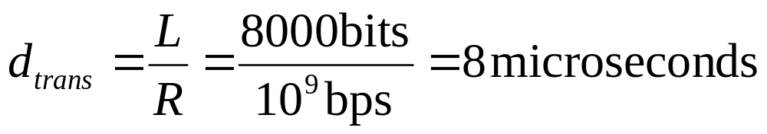

Performance of rdt3.0
rdt3.0 works, but performance stinks
ex: 1 Gbps link, 15 ms prop. delay, 8000 bit packet:
  U _{sender}: utilization – fraction of time sender busy sending
  1KB pkt every 30 msec -> 33kB/sec thruput over 1 Gbps link
  network protocol limits use of physical resources!
Transport Layer
3-<number>

Slide 54
rdt3.0: stop-and-wait operation
sender
receiver
first packet bit transmitted, t = 0
last packet bit transmitted, t = L / R
first packet bit arrives
RTT
last packet bit arrives, send ACK
ACK arrives, send next
packet, t = RTT + L / R
Transport Layer
3-<number>

Slide 55

Pipelined protocols
Pipelining: sender allows multiple, “in-flight”, yet-to-be-acknowledged pkts
  range of sequence numbers must be increased
  buffering at sender and/or receiver
Two generic forms of pipelined protocols: go-Back-N, selective repeat
Transport Layer
3-<number>

Slide 56

Pipelining: increased utilization
sender
receiver
first packet bit transmitted, t = 0
last bit transmitted, t = L / R
first packet bit arrives
RTT
last packet bit arrives, send ACK
last bit of 2nd packet arrives, send ACK
last bit of 3rd packet arrives, send ACK
ACK arrives, send next
packet, t = RTT + L / R
Increase utilization
by a factor of 3!
Transport Layer
3-<number>

Slide 57
Pipelining Protocols
Go-back-N: big picture:
Sender can have up to N unacked packets in pipeline
Rcvr only sends cumulative acks
  Doesn’t ack packet if there’s a gap
Sender has timer for oldest unacked packet
  If timer expires, retransmit all unacked packets
Selective Repeat: big pic
Sender can have up to N unacked packets in pipeline
Rcvr acks individual packets
Sender maintains timer for each unacked packet
  When timer expires, retransmit only unack packet
Transport Layer
3-<number>

Slide 58

Go-Back-N
Sender:
k-bit seq # in pkt header
“window” of up to N, consecutive unack’ed pkts allowed
ACK(n): ACKs all pkts up to, including seq # n — “cumulative ACK”
  may receive duplicate ACKs (see receiver)
timer for each in-flight pkt
timeout(n): retransmit pkt n and all higher seq # pkts in window
Transport Layer
3-<number>

Slide 59
GBN: sender extended FSM
rdt_send(data)
if (nextseqnum < base+N) {
sndpkt[nextseqnum] = make_pkt(nextseqnum,data,chksum)
udt_send(sndpkt[nextseqnum])
if (base == nextseqnum)
start_timer
nextseqnum++
}
else
refuse_data(data)
Λ
base=1
nextseqnum=1
timeout
Wait
start_timer
udt_send(sndpkt[base])
udt_send(sndpkt[base+1])
…
udt_send(sndpkt[nextseqnum-1])
rdt_rcv(rcvpkt)
&& corrupt(rcvpkt)
rdt_rcv(rcvpkt) &&
notcorrupt(rcvpkt)
base = getacknum(rcvpkt)+1
If (base == nextseqnum)
stop_timer
else
start_timer
Transport Layer
3-<number>

Slide 60
GBN: receiver extended FSM
default
udt_send(sndpkt)
rdt_rcv(rcvpkt)
&& notcurrupt(rcvpkt)
&& hasseqnum(rcvpkt,expectedseqnum)
Λ
Wait
extract(rcvpkt,data)
deliver_data(data)
sndpkt = make_pkt(expectedseqnum,ACK,chksum)
udt_send(sndpkt)
expectedseqnum++
expectedseqnum=1
sndpkt =
make_pkt(expectedseqnum,ACK,chksum)
ACK-only: always send ACK for correctly-received pkt with highest in-order seq #
  may generate duplicate ACKs
  need only remember expectedseqnum
out-of-order pkt:
  discard (don’t buffer) -> no receiver buffering!
  Re-ACK pkt with highest in-order seq #
Transport Layer
3-<number>

Slide 61

GBN in action
Transport Layer
3-<number>

Slide 62
Selective repeat: big picture
Sender can have up to N unacked packets in pipeline
Rcvr acks individual packets
Sender maintains timer for each unacked packet
  When timer expires, retransmit only unack packet
Transport Layer
3-<number>

Slide 63
Selective Repeat
receiver individually acknowledges all correctly received pkts
  buffers pkts, as needed, for eventual in-order delivery to upper layer
sender only resends pkts for which ACK not received
  sender timer for each unACKed pkt
sender window
  N consecutive seq #’s
  again limits seq #s of sent, unACKed pkts
Transport Layer
3-<number>

Slide 64

Selective repeat: sender, receiver windows
Transport Layer
3-<number>

Slide 65
Selective repeat
sender
receiver
data from above :
if next available seq # in window, send pkt
timeout(n):
resend pkt n, restart timer
ACK(n) in [sendbase,sendbase+N]:
mark pkt n as received
if n smallest unACKed pkt, advance window base to next unACKed seq #
pkt n in [rcvbase, rcvbase+N-1]
send ACK(n)
out-of-order: buffer
in-order: deliver (also deliver buffered, in-order pkts), advance window to next not-yet-received pkt
pkt n in [rcvbase-N,rcvbase-1]
ACK(n)
otherwise:
ignore
Transport Layer
3-<number>

Slide 66

Selective repeat in action
Pkt2 loss
发送窗口满是什么含义？
Transport Layer
3-<number>

Slide 67

Selective repeat: dilemma
Example:
seq #’s: 0, 1, 2, 3
window size=3
receiver sees no difference in two scenarios!
incorrectly passes duplicate data as new in (a)
Q: what relationship between seq # size and window size?
重传的pkt0
新的pkt0
Transport Layer
3-<number>

Slide 68
Chapter 3 outline
3.1 Transport-layer services
3.2 Multiplexing and demultiplexing
3.3 Connectionless transport: UDP
3.4 Principles of reliable data transfer
3.5 Connection-oriented transport: TCP
  segment structure
  reliable data transfer
  flow control
  connection management
3.6 Principles of congestion control
3.7 TCP congestion control
Transport Layer
3-<number>

Slide 69

TCP: Overview RFCs: 793, 1122, 1323, 2018, 2581
point-to-point:
  one sender, one receiver
reliable, in-order byte steam:
  no “message boundaries”
pipelined:
  TCP congestion and flow control set window size
send & receive buffers
full duplex data:
  bi-directional data flow in same connection
  MSS: maximum segment size
connection-oriented:
  handshaking (exchange of control msgs) init’s sender, receiver state before data exchange
flow controlled:
  sender will not overwhelm receiver
Transport Layer
3-<number>

Slide 70
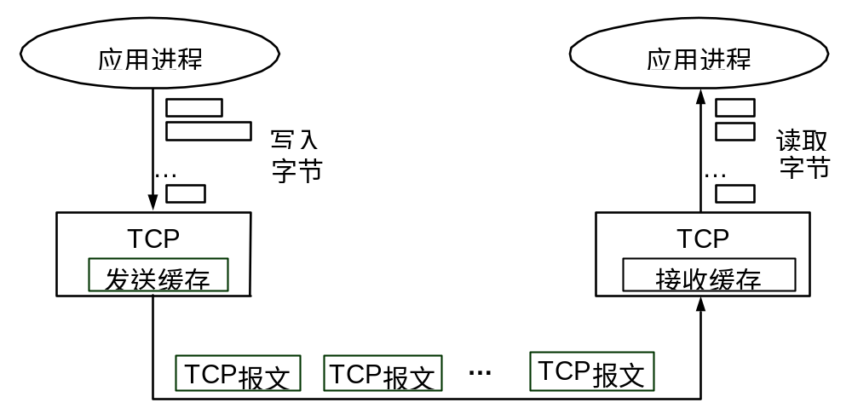
字节流

Slide 71
TCP segment structure
32 bits
URG: urgent data
(generally not used)
counting
by bytes
of data
(not segments!)
source port #
dest port #
sequence number
ACK: ACK #
valid
acknowledgement number
head
len
not
used
U
Receive window
A
PSH: push data now
(generally not used)
P
R
S
F
# bytes
rcvr willing
to accept
checksum
Urg data pnter
RST, SYN, FIN:
connection estab
(setup, teardown
commands)
Options (variable length)
application
data
(variable length)
Internet
checksum
(as in UDP)
Transport Layer
3-<number>

Slide 72
TCP seq. #’s and ACKs
Seq. #’s:
  byte stream “number” of first byte in segment’s data
ACKs:
  seq # of next byte expected from other side
  cumulative ACK
Q: how receiver handles out-of-order segments
  A: TCP spec doesn’t say, - up to implementor
Host A
Host B
User
types
‘C’
Seq=42, ACK=79, data = ‘C’
host ACKs
receipt of
‘C’, echoes
back ‘C’
Seq=79, ACK=43, data = ‘C’
host ACKs
receipt
of echoed
‘C’
Seq=43, ACK=80
time
simple telnet scenario
Transport Layer
3-<number>

Slide 73
TCP Round Trip Time and Timeout
Q: how to set TCP timeout value?
longer than RTT
  but RTT varies
too short: premature【过早的、不成熟的】 timeout
  unnecessary retransmissions
too long: slow reaction to segment loss
Q: how to estimate RTT?
SampleRTT: measured time from segment transmission until ACK receipt
  ignore retransmissions
SampleRTT will vary, want estimated RTT “smoother”
  average several recent measurements【最近几个采样值的算术平均】, not just current SampleRTT【峰值】
Transport Layer
3-<number>

Slide 74
TCP Round Trip Time and Timeout
EstimatedRTT = (1- α)*EstimatedRTT + α*SampleRTT
Exponential weighted moving average【指数加权移动平均】
influence of past sample decreases exponentially【1- α】 fast
typical value: α = 0.125
Homework：Problem 27
Transport Layer
3-<number>

Slide 75

Example RTT estimation:
Transport Layer
3-<number>

Slide 76
TCP Round Trip Time and Timeout
Setting the timeout
EstimtedRTT plus “safety margin【边际，变化】”
  large variation in EstimatedRTT -> larger safety margin
first estimate of how much SampleRTT deviates from EstimatedRTT:
DevRTT = (1-β)*DevRTT +
β*|SampleRTT-EstimatedRTT|
(typically, β = 0.25)
Then set timeout interval:
TimeoutInterval = EstimatedRTT + 4*DevRTT
Transport Layer
3-<number>

Slide 77
Chapter 3 outline
3.1 Transport-layer services
3.2 Multiplexing and demultiplexing
3.3 Connectionless transport: UDP
3.4 Principles of reliable data transfer
3.5 Connection-oriented transport: TCP
  segment structure
  reliable data transfer
  flow control
  connection management
3.6 Principles of congestion control
3.7 TCP congestion control
Transport Layer
3-<number>

Slide 78
TCP reliable data transfer
TCP creates rdt service on top of IP’s unreliable service
Pipelined segments
Cumulative acks
TCP uses single retransmission timer
Retransmissions are triggered by:
  timeout events
  duplicate acks
Initially consider simplified TCP sender:
  ignore duplicate acks
  ignore flow control, congestion control
Transport Layer
3-<number>

Slide 79
TCP sender events:
data rcvd from app:
Create segment with seq #
seq # is byte-stream number of first data byte in segment
start timer if not already running (think of timer as for oldest unacked segment)
expiration interval: TimeOutInterval
timeout:
retransmit segment that caused timeout
restart timer
Ack rcvd:
If acknowledges previously unacked segments
  update what is known to be acked
  start timer if there are outstanding segments
Transport Layer
3-<number>

Slide 80
TCP sender
(simplified)
NextSeqNum = InitialSeqNum
SendBase = InitialSeqNum
loop (forever) {
switch(event)
event: data received from application above
create TCP segment with sequence number NextSeqNum
if (timer currently not running)
start timer
pass segment to IP
NextSeqNum = NextSeqNum + length(data)
event: timer timeout
retransmit not-yet-acknowledged segment with
smallest sequence number
start timer
event: ACK received, with ACK field value of y
if (y > SendBase) {
SendBase = y
if (there are currently not-yet-acknowledged segments)
start timer
}
} /* end of loop forever */
Comment:
SendBase-1: last
cumulatively
ack’ed byte
Example:
SendBase-1 = 71;
y= 73, so the rcvr
wants 73+ ;
y > SendBase, so
that new data is
acked
Transport Layer
3-<number>

Slide 81
TCP: retransmission scenarios
Host A
Host B
Host A
Host B
Seq=92, 8 bytes data
Seq=92, 8 bytes data
Seq=100, 20 bytes data
timeout
ACK=100
Seq=92 timeout
X
ACK=100
loss
ACK=120
Seq=92, 8 bytes data
Sendbase
= 100
Seq=92, 8 bytes data
SendBase
= 120
Seq=92 timeout
ACK=120
ACK=100
SendBase
= 100
SendBase
= 120
time
time
premature timeout
lost ACK scenario
Transport Layer
3-<number>

Slide 82
TCP retransmission scenarios (more)
Host A
Host B
Seq=92, 8 bytes data
ACK=100
timeout
Seq=100, 20 bytes data
X
loss
SendBase
= 120
ACK=120
time
Cumulative ACK scenario
Transport Layer
3-<number>

Slide 83
TCP ACK generation [RFC 1122, RFC 2581]
Event at Receiver
Arrival of in-order segment with
expected seq #. All data up to
expected seq # already ACKed
Arrival of in-order segment with
expected seq #. One other
segment has ACK pending
Arrival of out-of-order segment
higher-than-expect seq. # .
Gap detected
Arrival of segment that
partially or completely fills gap
TCP Receiver action
Delayed ACK. Wait up to 500ms
for next segment. If no next segment,
send ACK
Immediately send single cumulative
ACK, ACKing both in-order segments
Immediately send duplicate ACK,
indicating seq. # of next expected byte
Immediate send ACK, provided that
segment starts at lower end of gap
Transport Layer
3-<number>

Slide 84
Fast Retransmit
Time-out period often relatively long:
  long delay before resending lost packet
Detect lost segments via duplicate ACKs.
  Sender often sends many segments back-to-back
  If segment is lost, there will likely be many duplicate ACKs.
If sender receives 3 ACKs for the same data, it supposes that segment after ACKed data was lost:
  fast retransmit: resend segment before timer expires
Transport Layer
3-<number>

Slide 85
Host A
Host B
X
timeout
resend 2nd segment
time
Figure 3.37 Resending a segment after triple duplicate ACK
Transport Layer
3-<number>

Slide 86
Fast retransmit algorithm:
event: ACK received, with ACK field value of y
if (y > SendBase) {
SendBase = y
if (there are currently not-yet-acknowledged segments)
start timer
}
else {
increment count of dup ACKs received for y
if (count of dup ACKs received for y = 3) {
resend segment with sequence number y
}
a duplicate ACK for
already ACKed segment
fast retransmit
Transport Layer
3-<number>

Slide 87
Chapter 3 outline
3.1 Transport-layer services
3.2 Multiplexing and demultiplexing
3.3 Connectionless transport: UDP
3.4 Principles of reliable data transfer
3.5 Connection-oriented transport: TCP
  segment structure
  reliable data transfer
  flow control
  connection management
3.6 Principles of congestion control
3.7 TCP congestion control
Transport Layer
3-<number>

Slide 88

TCP Flow Control
flow control
sender won’t overflow
receiver’s buffer by
transmitting too much,
too fast
receive side of TCP connection has a receive buffer:
speed-matching service: matching the send rate to the receiving app’s drain rate
app process may be slow at reading from buffer
Transport Layer
3-<number>

Slide 89
TCP Flow control: how it works
Rcvr advertises spare room by including value of RcvWindow in segments
Sender limits unACKed data to RcvWindow
  guarantees receive buffer doesn’t overflow
(Suppose TCP receiver discards out-of-order segments)
spare room in buffer
= RcvWindow
= RcvBuffer-[LastByteRcvd - LastByteRead]
Transport Layer
3-<number>

Slide 90
Chapter 3 outline
3.1 Transport-layer services
3.2 Multiplexing and demultiplexing
3.3 Connectionless transport: UDP
3.4 Principles of reliable data transfer
3.5 Connection-oriented transport: TCP
  segment structure
  reliable data transfer
  flow control
  connection management
3.6 Principles of congestion control
3.7 TCP congestion control
Transport Layer
3-<number>

Slide 91
TCP Connection Management
Recall: TCP sender, receiver establish “connection” before exchanging data segments
initialize TCP variables:
  seq. #s
  buffers, flow control info (e.g. RcvWindow)
client: connection initiator
Socket clientSocket = new Socket("hostname","port number");
server: contacted by client
Socket connectionSocket = welcomeSocket.accept();
Three way handshake:
Step 1: client host sends TCP SYN segment to server
  specifies initial seq #
  no data
Step 2: server host receives SYN, replies with SYNACK segment
  server allocates buffers
  specifies server initial seq. #
Step 3: client receives SYNACK, replies with ACK segment, which may contain data
Transport Layer
3-<number>

Slide 92
TCP Connection Management (cont.)
Closing a connection:
client closes socket: clientSocket.close();
Step 1: client end system sends TCP FIN control segment to server
Step 2: server receives FIN, replies with ACK. Closes connection, sends FIN.
client
server
close
FIN
ACK
close
FIN
ACK
timed wait
closed
Transport Layer
3-<number>

Slide 93
TCP Connection Management (cont.)
Step 3: client receives FIN, replies with ACK.
  Enters “timed wait” - will respond with ACK to received FINs
Step 4: server, receives ACK. Connection closed.
Note: with small modification, can handle simultaneous FINs.
client
server
closing
FIN
ACK
closing
FIN
ACK
timed wait
closed
closed
Transport Layer
3-<number>

Slide 94


TCP Connection Management (cont)
TCP server
lifecycle
TCP client
lifecycle
Transport Layer
3-<number>

Slide 95
Chapter 3 outline
3.1 Transport-layer services
3.2 Multiplexing and demultiplexing
3.3 Connectionless transport: UDP
3.4 Principles of reliable data transfer
3.5 Connection-oriented transport: TCP
  segment structure
  reliable data transfer
  flow control
  connection management
3.6 Principles of congestion control
3.7 TCP congestion control
Transport Layer
3-<number>

Slide 96
Principles of Congestion Control
Congestion:
informally: “too many sources sending too much data too fast for network to handle”
different from flow control!
manifestations:
  lost packets (buffer overflow at routers)
  long delays (queueing in router buffers)
a top-10 problem!
Transport Layer
3-<number>

Slide 97

Causes/costs of congestion: scenario 1
two senders, two receivers
one router, infinite buffers
no retransmission
Host A
λ_{in} : original data
λ_{out}
Host B
unlimited shared output link buffers
large delays when congested
maximum achievable throughput
Transport Layer
3-<number>

Slide 98
Causes/costs of congestion: scenario 2
one router, finite buffers
sender retransmission of lost packet
Host A
λ_{in} : original data
λ_{out}
λ'_{in} : original data, plus retransmitted data
Host B
finite shared output link buffers
Transport Layer
3-<number>

Slide 99
Causes/costs of congestion: scenario 2
λ
λ
always: (goodput)
“perfect” retransmission only when loss:
retransmission of delayed (not lost) packet makes larger (than perfect case) for same
=
in
out
λ
>
λ
in
out
λ
in
λ
out
R/2
R/2
R/2
R/3
λ_{out}
λ_{out}
λ_{out}
R/4
λ_{in}
R/2
λ_{in}
R/2
λ_{in}
R/2
a.
b.
c.
“costs” of congestion:
more work (retrans) for given “goodput”
unneeded retransmissions: link carries multiple copies of pkt
Transport Layer
3-<number>

Slide 100
Causes/costs of congestion: scenario 3
λ
four senders
multihop paths
timeout/retransmit
Q: what happens as and increase ?
λ
in
in
Host A
λ_{in} : original data
λ_{out}
λ'_{in} : original data, plus retransmitted data
finite shared output link buffers
Host B
Transport Layer
3-<number>

Slide 101

Causes/costs of congestion: scenario 3
Host A
λ_{out}
Host B
Another “cost” of congestion:
when packet dropped, any “upstream transmission capacity used for that packet was wasted!
Transport Layer
3-<number>

Slide 102
Approaches towards congestion control
Two broad approaches towards congestion control:
End-end congestion control:
no explicit feedback from network
congestion inferred from end-system observed loss, delay
approach taken by TCP
Network-assisted congestion control:
routers provide feedback to end systems
  single bit indicating congestion (SNA, DECbit, TCP/IP ECN, ATM)
  explicit rate sender should send at
Transport Layer
3-<number>

Slide 103
Case study: ATM ABR congestion control
ABR: available bit rate:
“elastic service”
if sender’s path “underloaded”:
  sender should use available bandwidth
if sender’s path congested:
  sender throttled to minimum guaranteed rate
RM (resource management) cells:
sent by sender, interspersed with data cells
bits in RM cell set by switches (“network-assisted”)
  NI bit: no increase in rate (mild congestion)
  CI bit: congestion indication
RM cells returned to sender by receiver, with bits intact
Transport Layer
3-<number>

Slide 104

Case study: ATM ABR congestion control
two-byte ER (explicit rate) field in RM cell
  congested switch may lower ER value in cell
  sender’ send rate thus maximum supportable rate on path
EFCI bit in data cells: set to 1 in congested switch
  if data cell preceding RM cell has EFCI set, sender sets CI bit in returned RM cell
Transport Layer
3-<number>

Slide 105
Chapter 3 outline
3.1 Transport-layer services
3.2 Multiplexing and demultiplexing
3.3 Connectionless transport: UDP
3.4 Principles of reliable data transfer
3.5 Connection-oriented transport: TCP
  segment structure
  reliable data transfer
  flow control
  connection management
3.6 Principles of congestion control
3.7 TCP congestion control
Transport Layer
3-<number>

Slide 106

TCP congestion control: additive increase, multiplicative decrease
Approach: increase transmission rate (window size), probing for usable bandwidth, until loss occurs
  additive increase: increase CongWin by 1 MSS every RTT until loss detected
  multiplicative decrease: cut CongWin in half after loss
Saw tooth
behavior: probing
for bandwidth
congestion window size
time
Transport Layer
3-<number>

Slide 107
TCP Congestion Control: details
sender limits transmission:
LastByteSent-LastByteAcked
≤ CongWin
Roughly,
CongWin is dynamic, function of perceived network congestion
How does sender perceive congestion?
loss event = timeout or 3 duplicate acks
TCP sender reduces rate (CongWin) after loss event
three mechanisms:
  AIMD
  slow start
  conservative after timeout events
CongWin
rate =
Bytes/sec
RTT
Transport Layer
3-<number>

Slide 108
TCP Slow Start
When connection begins, CongWin = 1 MSS
  Example: MSS = 500 bytes & RTT = 200 msec
  initial rate = 20 kbps
available bandwidth may be >> MSS/RTT
  desirable to quickly ramp up to respectable rate
When connection begins, increase rate exponentially fast until first loss event
Transport Layer
3-<number>

Slide 109
TCP Slow Start (more)
When connection begins, increase rate exponentially until first loss event:
  double CongWin every RTT
  done by incrementing CongWin for every ACK received
Summary: initial rate is slow but ramps up exponentially fast
Host A
Host B
one segment
RTT
two segments
four segments
time
Transport Layer
3-<number>

Slide 110
Refinement: inferring loss
After 3 dup ACKs:
  CongWin is cut in half
  window then grows linearly
But after timeout event:
  CongWin instead set to 1 MSS;
  window then grows exponentially
  to a threshold, then grows linearly
Philosophy:
3 dup ACKs indicates
network capable of
delivering some segments
timeout indicates a “more alarming” congestion scenario
Transport Layer
3-<number>

Slide 111

Refinement
Q: When should the exponential increase switch to linear?
A: When CongWin gets to 1/2 of its value before timeout.
Implementation:
Variable Threshold
At loss event, Threshold is set to 1/2 of CongWin just before loss event
Transport Layer
3-<number>

Slide 112
Summary: TCP Congestion Control
When CongWin is below Threshold, sender in slow-start phase, window grows exponentially.
When CongWin is above Threshold, sender is in congestion-avoidance phase, window grows linearly.
When a triple duplicate ACK occurs, Threshold set to CongWin/2 and CongWin set to Threshold.
When timeout occurs, Threshold set to CongWin/2 and CongWin is set to 1 MSS.
Transport Layer
3-<number>

Slide 113
TCP sender congestion control
State | Event | TCP Sender Action | Commentary
Slow Start (SS) | ACK receipt for previously unacked data | CongWin = CongWin + MSS, If (CongWin > Threshold) set state to “Congestion Avoidance” | Resulting in a doubling of CongWin every RTT
Congestion Avoidance (CA) | ACK receipt for previously unacked data | CongWin = CongWin+MSS * (MSS/CongWin) | Additive increase, resulting in increase of CongWin by 1 MSS every RTT
SS or CA | Loss event detected by triple duplicate ACK | Threshold = CongWin/2, CongWin = Threshold, Set state to “Congestion Avoidance” | Fast recovery, implementing multiplicative decrease. CongWin will not drop below 1 MSS.
SS or CA | Timeout | Threshold = CongWin/2, CongWin = 1 MSS, Set state to “Slow Start” | Enter slow start
SS or CA | Duplicate ACK | Increment duplicate ACK count for segment being acked | CongWin and Threshold not changed
Transport Layer
3-<number>

Slide 114
TCP throughput
What’s the average throughout of TCP as a function of window size and RTT?
  Ignore slow start
Let W be the window size when loss occurs.
When window is W, throughput is W/RTT
Just after loss, window drops to W/2, throughput to W/2RTT.
Average throughout: .75 W/RTT
Transport Layer
3-<number>

Slide 115

TCP Futures: TCP over “long, fat pipes”
Example: 1500 byte segments, 100ms RTT, want 10 Gbps throughput
Requires window size W = 83,333 in-flight segments
Throughput in terms of loss rate:
➜ L = 2·10⁻¹⁰ Wow
New versions of TCP for high-speed
Transport Layer
3-<number>

Slide 116
TCP Fairness
Fairness goal: if K TCP sessions share same bottleneck link of bandwidth R, each should have average rate of R/K
TCP connection 1
TCP
connection 2
bottleneck
router
capacity R
Transport Layer
3-<number>

Slide 117
Why is TCP fair?
Two competing sessions:
Additive increase gives slope of 1, as throughout increases
multiplicative decrease decreases throughput proportionally
R
equal bandwidth share
loss: decrease window by factor of 2
congestion avoidance: additive increase
Connection 2 throughput
loss: decrease window by factor of 2
congestion avoidance: additive increase
Connection 1 throughput
R
Transport Layer
3-<number>

Slide 118
Fairness (more)
Fairness and UDP
Multimedia apps often do not use TCP
  do not want rate throttled by congestion control
Instead use UDP:
  pump audio/video at constant rate, tolerate packet loss
Research area: TCP friendly
Fairness and parallel TCP connections
nothing prevents app from opening parallel connections between 2 hosts.
Web browsers do this
Example: link of rate R supporting 9 connections;
  new app asks for 1 TCP, gets rate R/10
  new app asks for 11 TCPs, gets R/2 !
Transport Layer
3-<number>

Slide 119
Chapter 3: Summary
principles behind transport layer services:
  multiplexing, demultiplexing
  reliable data transfer
  flow control
  congestion control
instantiation and implementation in the Internet
  UDP
  TCP
Next:
leaving the network “edge” (application, transport layers)
into the network “core”
Transport Layer
3-<number>

Slide 120
Homework
Review Questions: 3,6,7,9,10,11
Problems:21
Discussion: 1

